Slide 1



AirPick

Slide 2


Presented By
Group 7

Slide 3
Meet the group
Ke Jia
YangYang
RunZhou Zhu
QingYun Wang

Slide 4
Project Overview
Solve users' needs for airport pick-up and drop-off, and provide a platform for publishing transportation demand information.

Slide 5
Project Timeline
Week 1
Designed product prototypes and refined the workflow.
Week 4
Developed backend CRUD APIs for Users and Orders and established frontend-backend connectivity.
We formed the project team and finalized the product through brainstorming, outlining the core features and development direction.
Developed the homepage and implemented login and registration features.
Week 2-3
Week 5

Slide 6
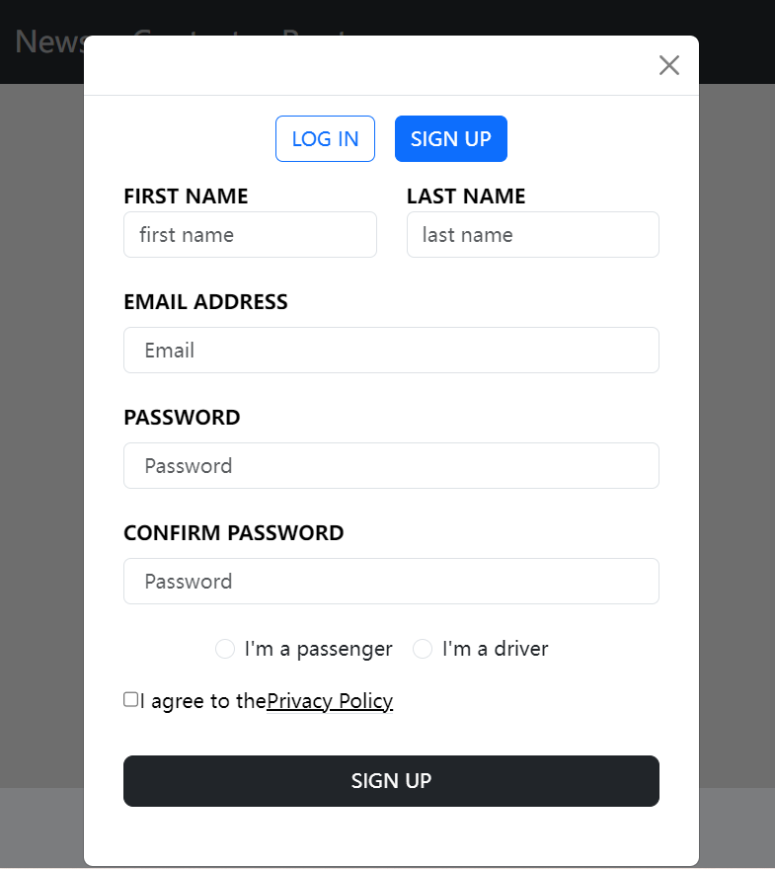
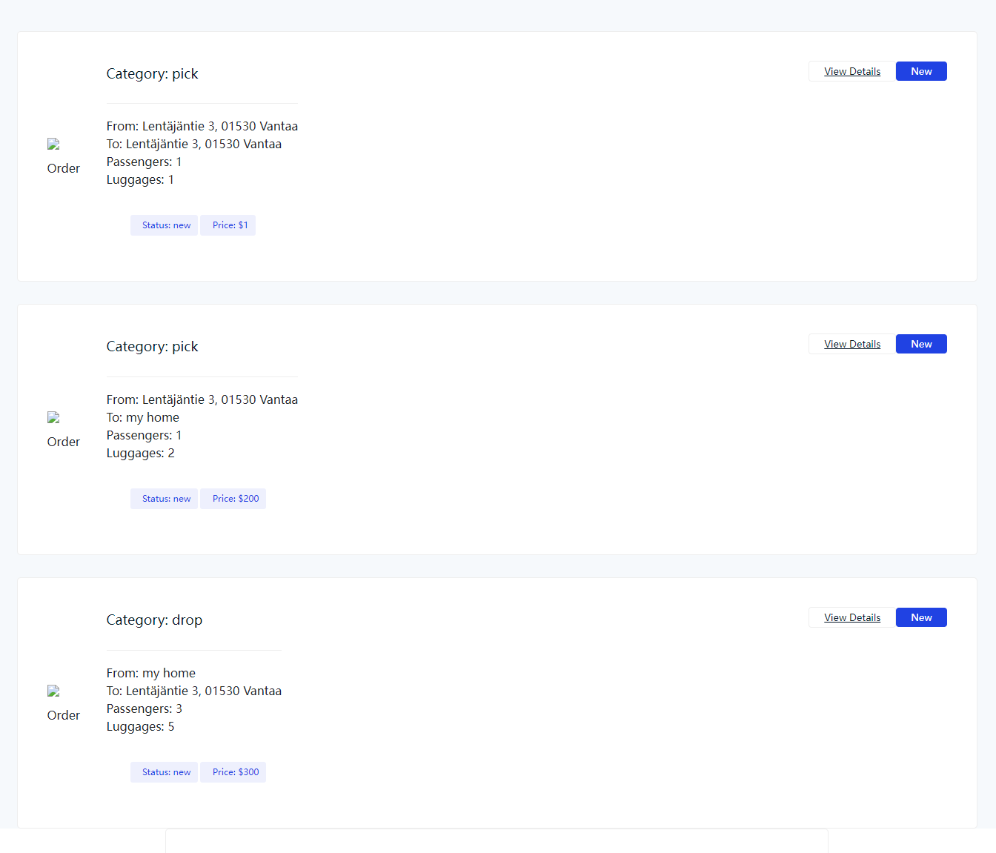
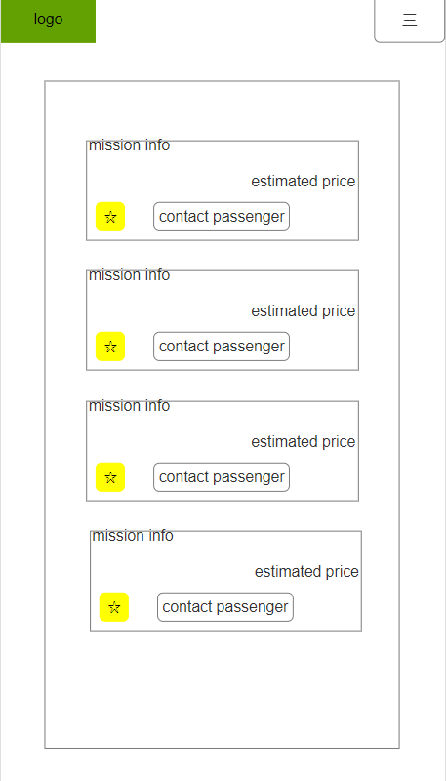
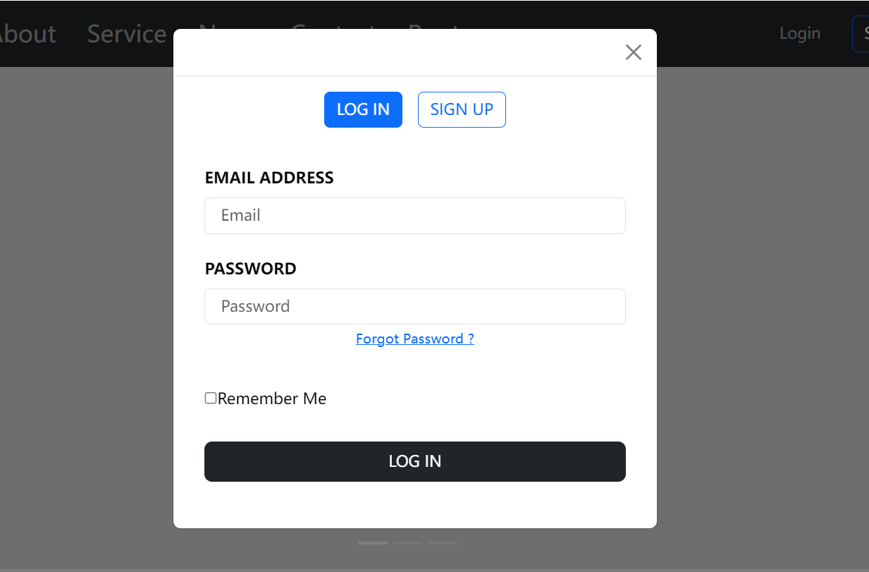
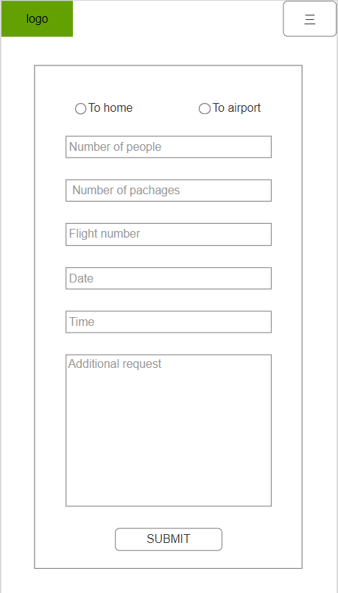
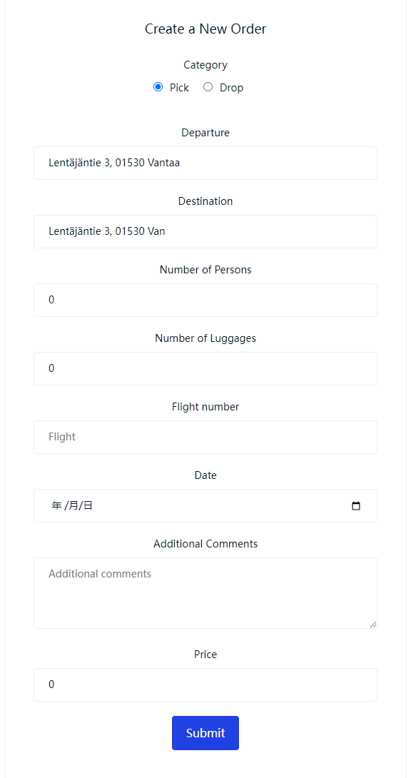
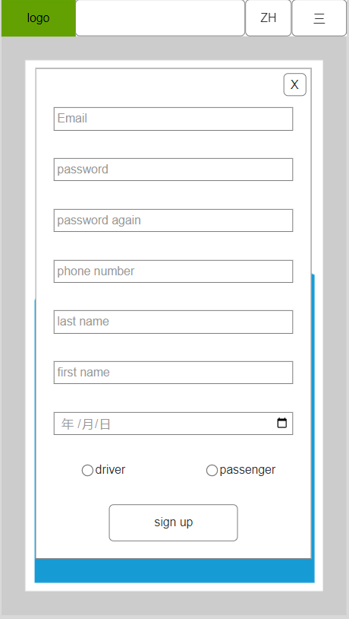
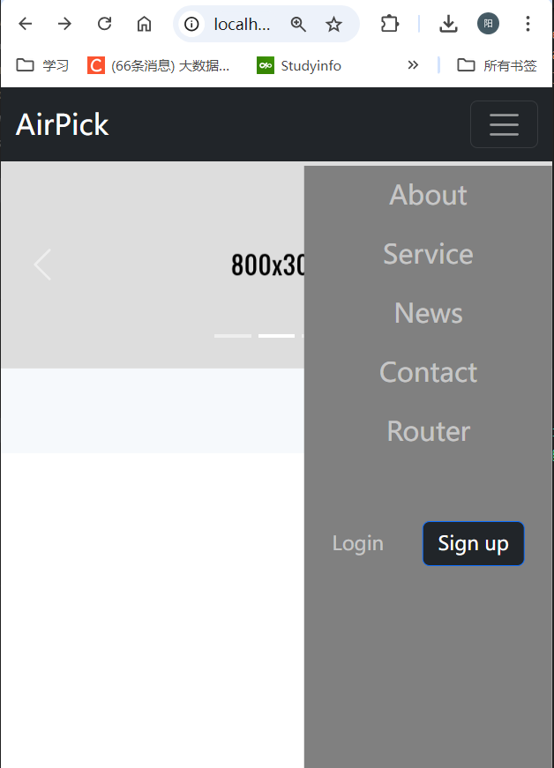
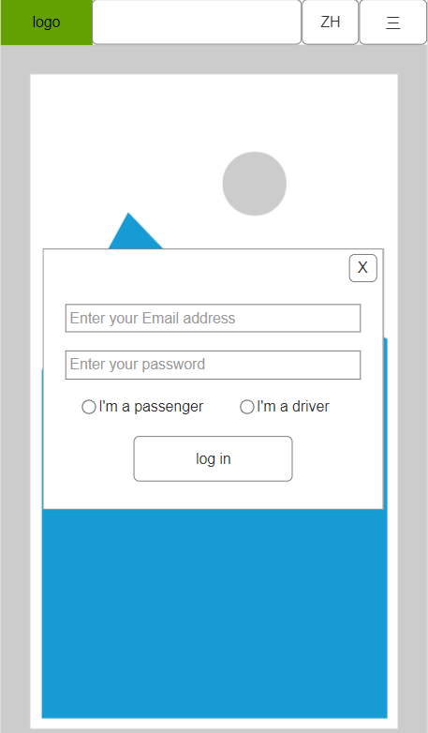
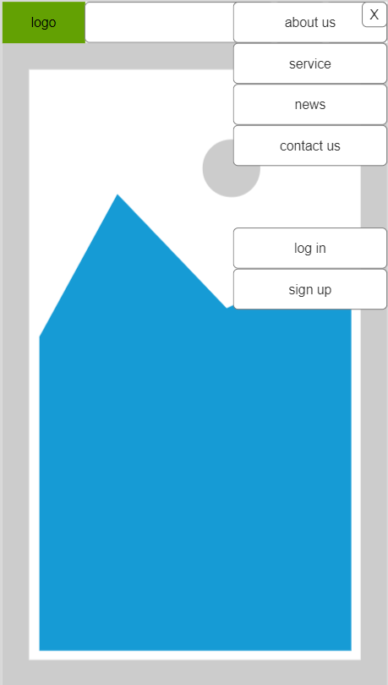
Project compare
prototype
AirPick

Slide 7
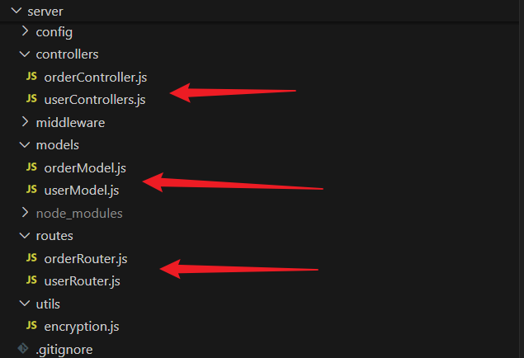
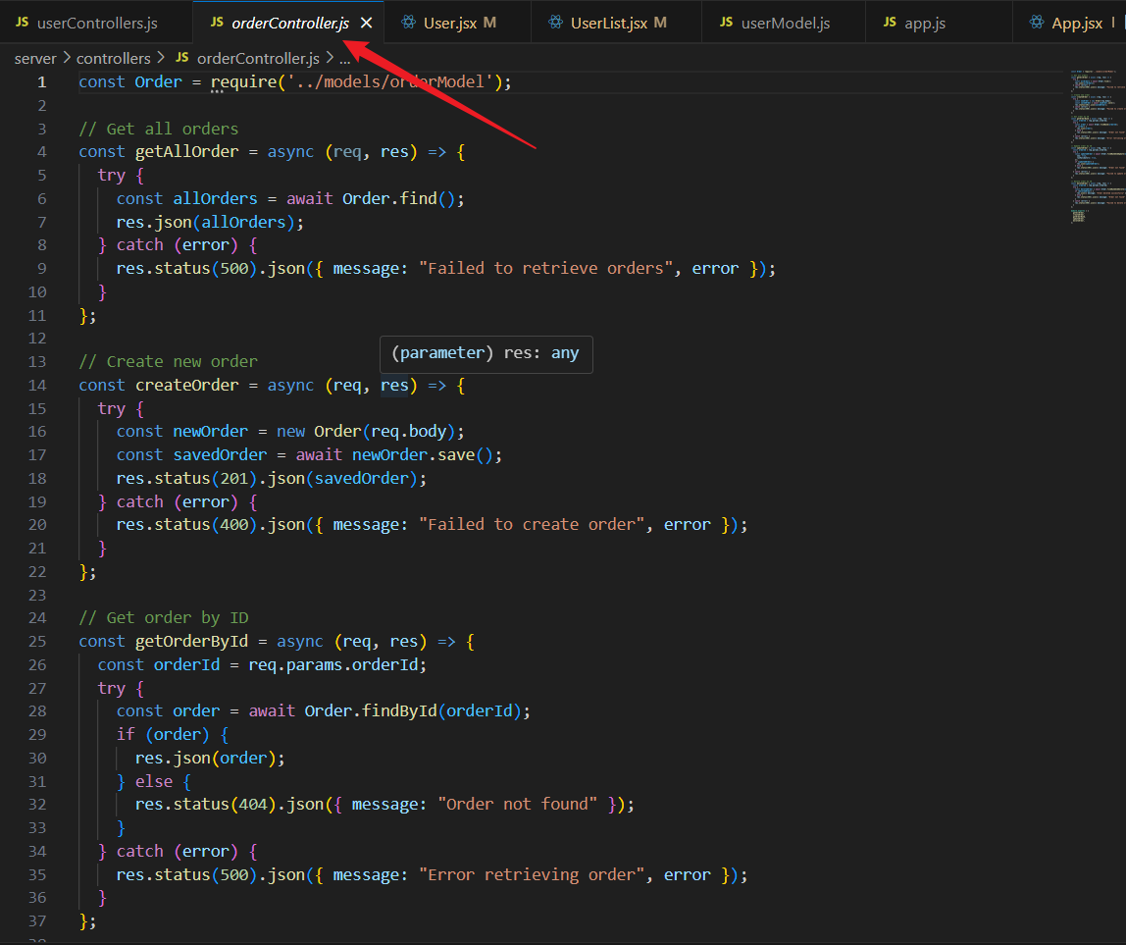
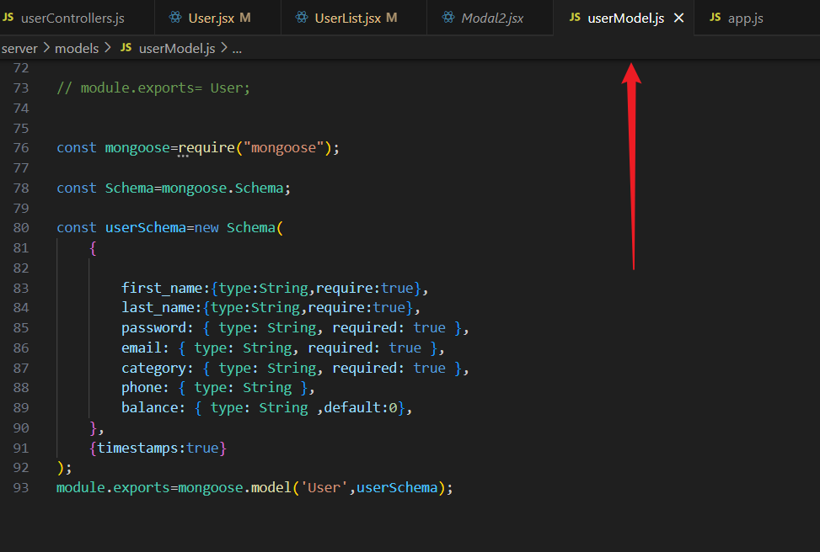
Backend Development
Order function development:
orderModel
orderController
orderRouter
01
User function development:
userModel
userController
userRouter
02

Slide 8


Daily Scrum
What did you do yesterday?
What will you do today?
Are there any obstacles in your way?

Slide 9
Sprint Review
Sprint goal review.
Demonstration.
Feedback.
Release plan.
Discussion.
Next steps.
01
02

Slide 10
Sprint Retrospective
What went well?
What went wrong?
What did you learn?
What changes can we make?
01
02

Slide 11
Conclusion
Last sprint summary : Model
Prospects next sprint : Connection

Slide 12
Does Anyone Have Questions?

Slide 13
Thank You

